Slide 1
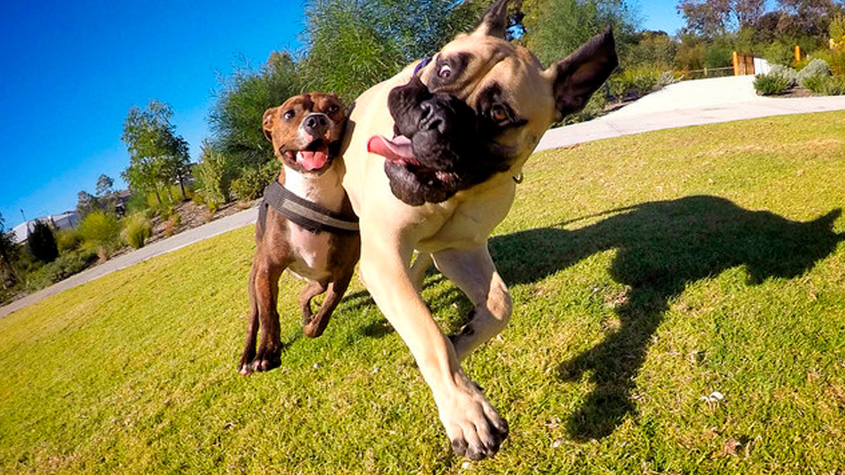
AR Pets
Josh, Kip, Elliot, Kyle, Kurt

Slide 2
What?
A game-like interface to simulate the possession of a pet using augmented reality technology. This app has multiple uses but the primary is to attempt to give the “player" a pet that they raise that has real time consequences and rewards.

Slide 3
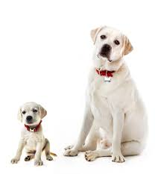
Features
Three-stage life-cycle from child to adolescent to adult.
User is responsible for care of the pet (feeding, playing, etc)
Progress will be denoted by an affection/joy meter, as it fills the user unlocks different tricks or a stage progression of the pets lifecycle.
Neglect can result in the pet running away
Custom modeling and animation

Slide 4
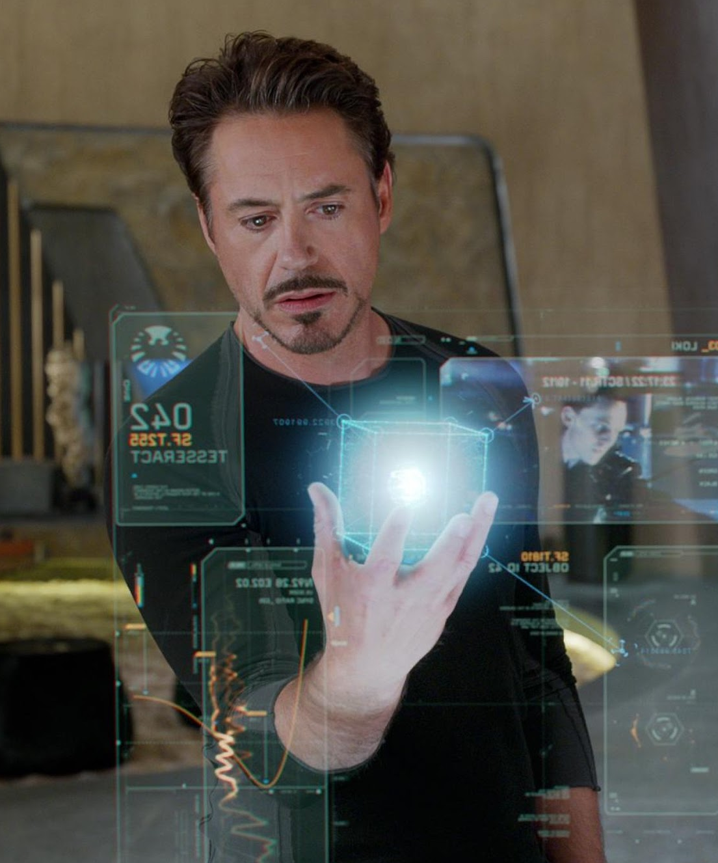
Why?
VR/AR is the future of human-computer interaction
No killer apps yet exist for the platform
Can we develop an emotional attachment?
How to interact? - What feels real?

Slide 5
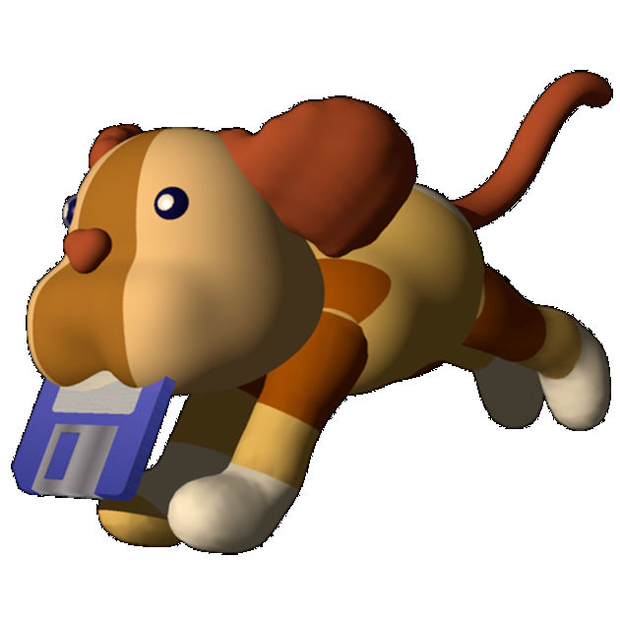
The Plan
Baseline Goal: Play fetch
Ball interaction
Physics
Animal interaction
Animation
Stretch Goal: Your new best friend
Emotions and unique personalities
Every pet is different
New tricks and games

Slide 6
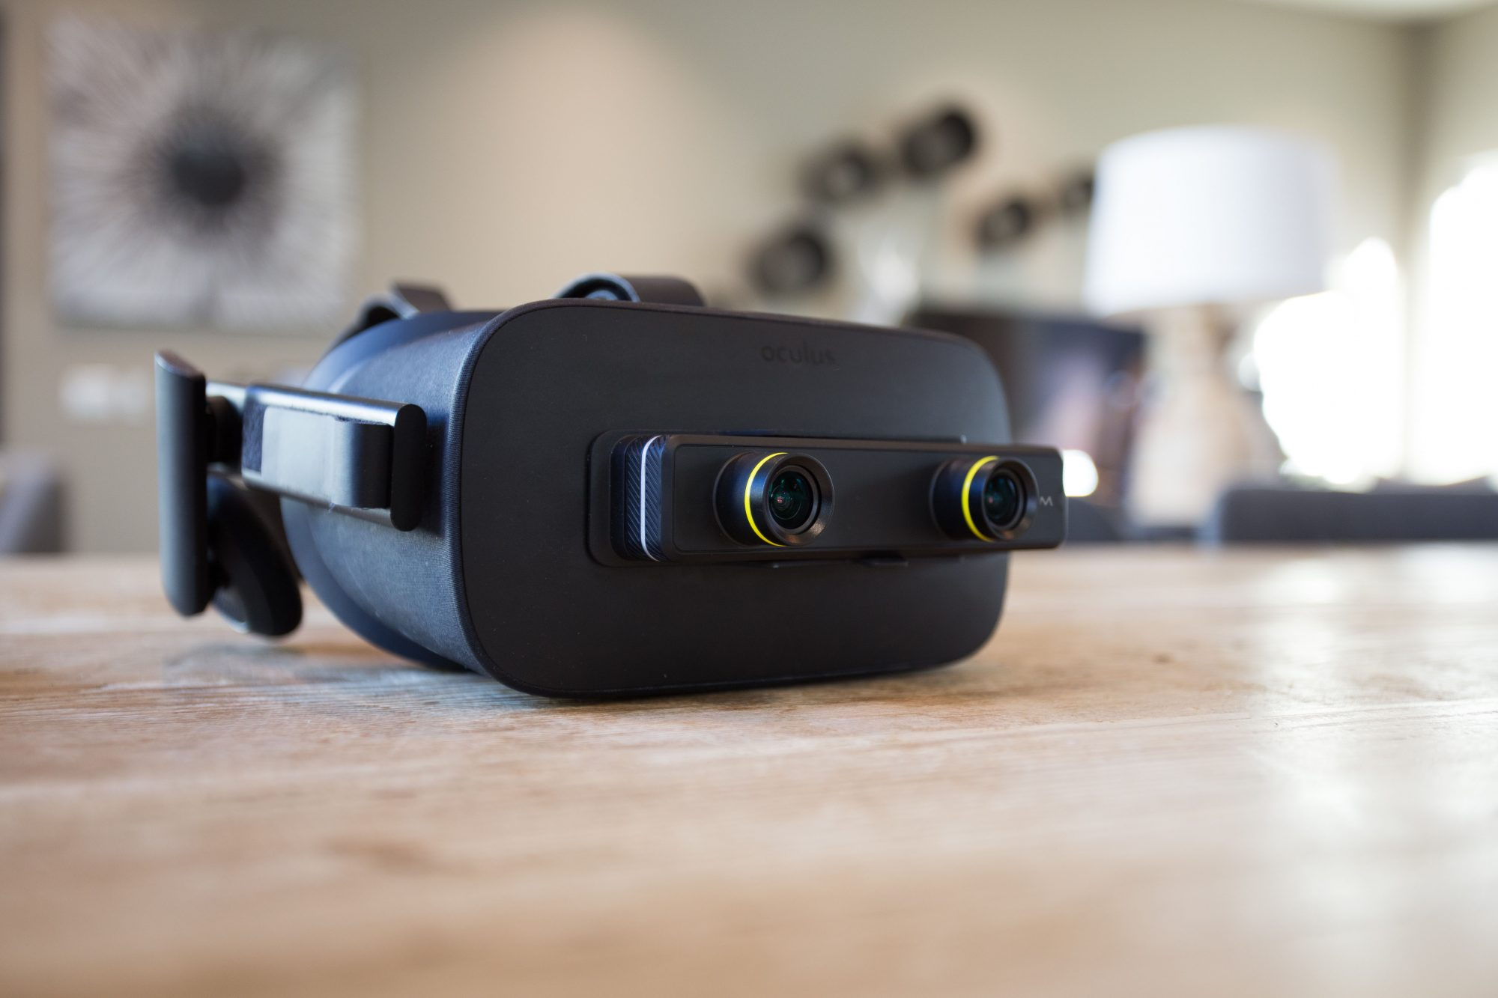
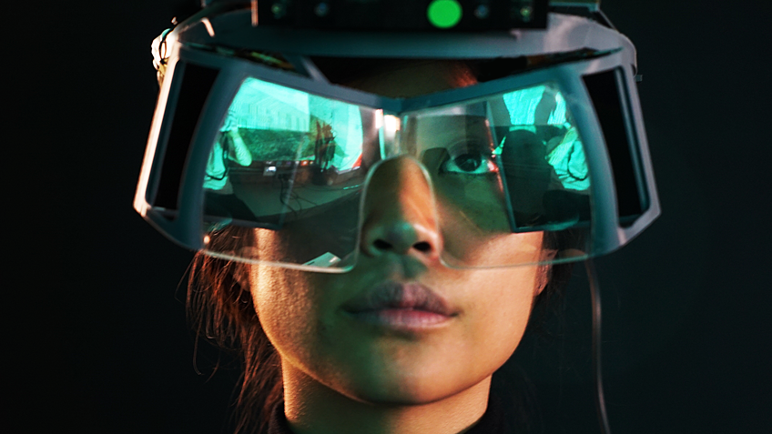
The Tech
Oculus Rift
Zed Mini
Project North Star??

Slide 7
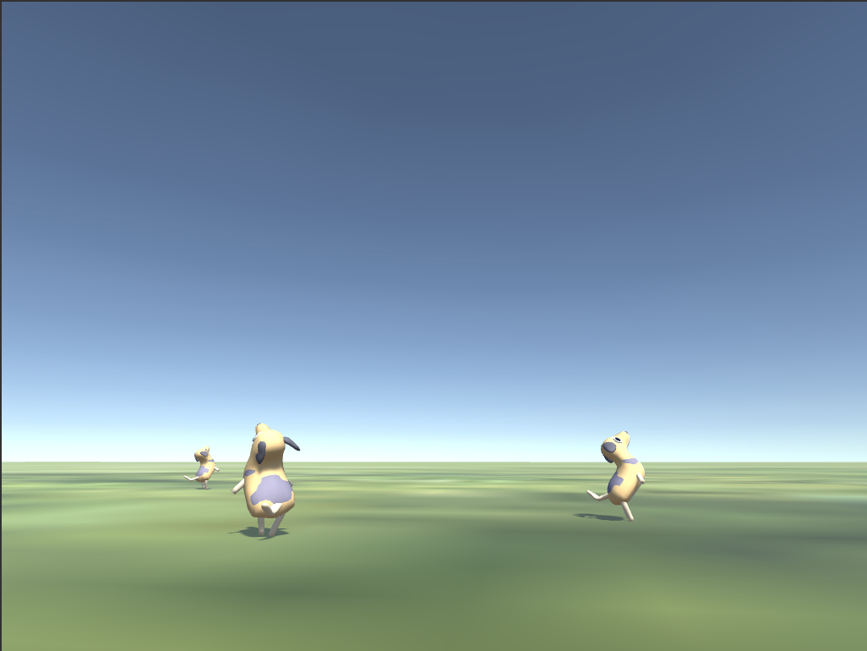
Current Research
Animation Planning
Modeling
Unity
AR Hardware

